Slide 1
Non-Linear Models and Simulation
NRES 776
Instructor: Heather Bryan
Nov 23, 2020

Slide 2
Learning Objectives
Use simulation for hypothesis testing
Use bootstrapping to calculate the standard error of an estimate and the confidence interval of a parameter

Slide 3
Computer-intensive methods
Permutation test (hypothesis testing)
Simulation (hypothesis testing)
Bootstrapping (calculating precision of estimates)

Slide 4
Hypothesis Testing using Simulation
Use a computer to create imaginary population with parameter values specified under null hypothesis

Slide 5
Hypothesis Testing using Simulation
Use a computer to create imaginary population with parameter values specified under null hypothesis
Sample from that imaginary population

Slide 6
Hypothesis Testing using Simulation
Use a computer to create imaginary population with parameter values specified under null hypothesis
Sample from that imaginary population
Calculate test statistic for that population

Slide 7
Hypothesis Testing using Simulation
Use a computer to create imaginary population with parameter values specified under null hypothesis
Sample from that imaginary population
Calculate test statistic for that population
Repeat many times and generate a frequency distribution for the test statistic

Slide 8
Hypothesis Testing using Simulation
Use a computer to create imaginary population with parameter values specified under null hypothesis
Sample from that imaginary population
Calculate test statistic for that population
Repeat many times and generate a frequency distribution for the test statistic
Frequency distribution for test statistic approximates null distribution for hypothesis test

Slide 9

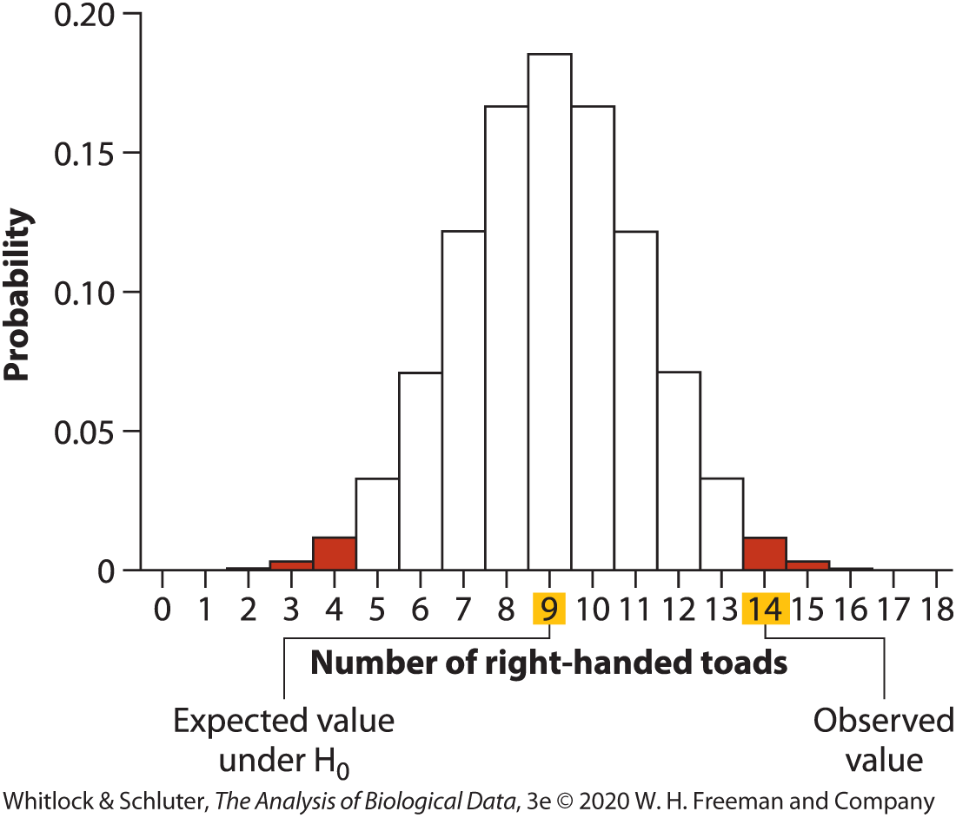
Simulation Example (Lecture 6)
# R-handed toads | P
0 | 0.000004
1 | 0.00007
2 | 0.0006
3 | 0.0031
4 | 0.0117
5 | 0.0327
6 | 0.0708
7 | 0.1214
8 | 0.1669
9 | 0.1855
10 | 0.1669
11 | 0.1214
12 | 0.0708
13 | 0.0327
14 | 0.0117
15 | 0.0031
16 | 0.0006
17 | 0.00007
18 | 0.000004
Total | 1.0

Slide 10
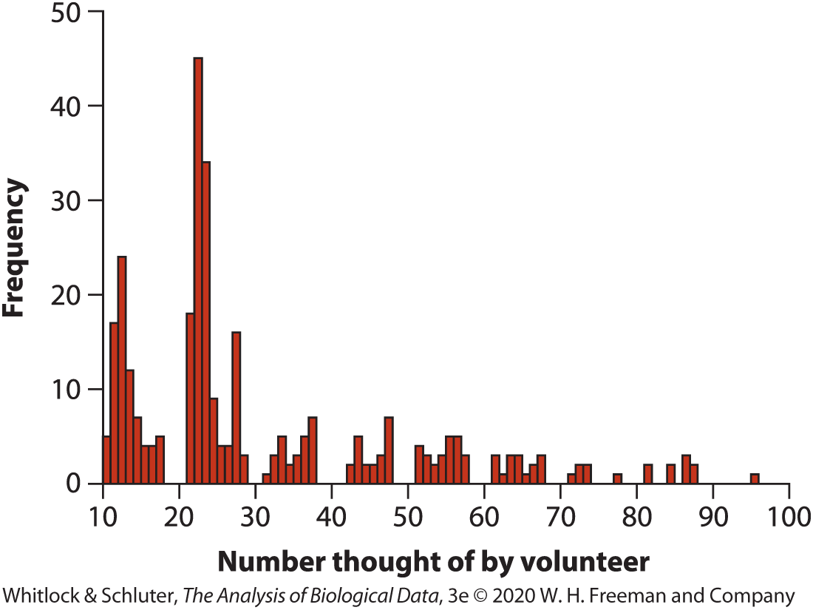
Simulation Example: haphazard choice
Notes:
-two-digit numbers chosen independently by 315 volunteers
-are two-digit numbers chosen with equal probability?

Slide 11
Simulation Example: haphazard choice
H₀: Two-digit numbers are chosen with equal probability
H₁: Two-digit numbers are not chosen with equal probability

Slide 12
Simulation Example: haphazard choice
H₀: Two-digit numbers are chosen with equal probability
H₁: Two-digit numbers are not chosen with equal probability
90 possible outcomes (integers between 10 and 99)

Slide 13
Simulation Example: haphazard choice
H₀: Two-digit numbers are chosen with equal probability
H₁: Two-digit numbers are not chosen with equal probability
90 possible outcomes (integers between 10 and 99)
Expected frequency of occurrence in each category 315/90 = 3.5

Slide 14
Simulation Example: haphazard choice
H₀: Two-digit numbers are chosen with equal probability
H₁: Two-digit numbers are not chosen with equal probability
90 possible outcomes (integers between 10 and 99)
Expected frequency of occurrence in each category 315/90 = 3.5
What would be an appropriate test?

Slide 15

Simulation Example: haphazard choice
H₀: Two-digit numbers are chosen with equal probability
H₁: Two-digit numbers are not chosen with equal probability
90 possible outcomes (integers between 10 and 99)
Expected frequency of occurrence in each category 315/90 = 3.5
What would be an appropriate test?
$χ^{2}$ goodness-of-fit test requires that ≤20% of categories have values <5
Need to simulate null distribution

Slide 16
Simulation Example: haphazard choice
Randomly draw 315 two-digit numbers between 10 and 99

Slide 17

Simulation Example: haphazard choice
Randomly draw 315 two-digit numbers between 10 and 99
Calculate test statistic ($χ^{2}$)

Slide 18

Simulation Example: haphazard choice
Randomly draw 315 two-digit numbers between 10 and 99
Calculate test statistic ($χ^{2}$)
Repeat 1 & 2 many times (e.g., 10000)
Simulation number | Simulated samples of 315 numbers (the first 5 numbers of each sample are shown) |  |  |  |  |  | Test statistic X²
1 | 71 | 28 | 50 | 41 | 54 | . . . | 86.1
2 | 35 | 62 | 52 | 90 | 48 | . . . | 80.5
3 | 29 | 27 | 64 | 24 | 47 | . . . | 95.4
4 | 37 | 91 | 40 | 67 | 67 | . . . | 78.4
5 | 20 | 64 | 40 | 37 | 49 | . . . | 87.7
6 | 26 | 31 | 23 | 40 | 51 | . . . | 96.9
7 | 95 | 16 | 64 | 59 | 64 | . . . | 95.4
8 | 57 | 10 | 21 | 79 | 51 | . . . | 106.7
9 | 18 | 81 | 91 | 52 | 95 | . . . | 92.3
10 | 14 | 98 | 35 | 99 | 54 | . . . | 100.5
. . . |  |  |  |  |  |  | . . .

Slide 19
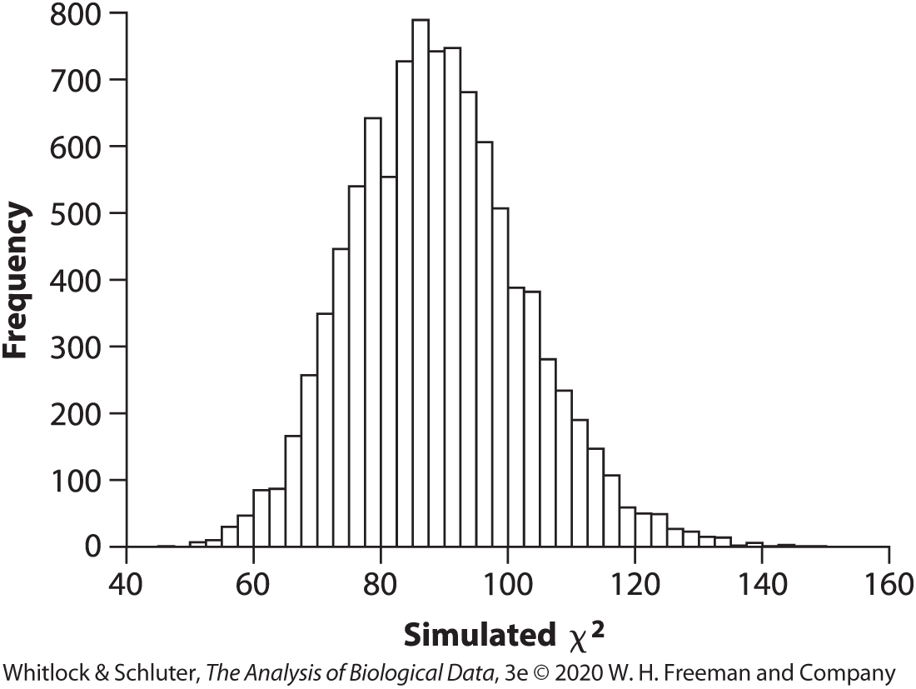

Simulation Example: haphazard choice
Randomly draw 315 two-digit numbers between 10 and 99
Calculate test statistic ($χ^{2}$)
Repeat 1 & 2 many times (e.g., 10000)
Use simulated values of test statistic to generate null distribution

Slide 20


Simulation Example: haphazard choice
Randomly draw 315 two-digit numbers between 10 and 99
Calculate test statistic ($χ^{2}$)
Repeat 1 & 2 many times (e.g., 10000)
Use simulated values of test statistic to generate null distribution
Compare test statistic from data to the null distribution
$χ^{2}$ = 1231.0
P<1 in 10000

Slide 21

Bootstrapping
Uses resampling from the data to approximate the sampling distribution of the estimate
Notes:
Image: https://www.survivingburningman.com/2017/08/06/shoes-bring-burning-man/

Slide 22
Bootstrapping
Uses resampling from the data to approximate the sampling distribution of the estimate
Used to find a standard error of an estimate or confidence interval for a parameter estimate
Notes:
Image: https://www.survivingburningman.com/2017/08/06/shoes-bring-burning-man/

Slide 23
Bootstrapping
Uses resampling from the data to approximate the sampling distribution of the estimate
Used to find a standard error of an estimate or confidence interval for a parameter estimate
Useful when no formula is available for the standard error or when the sampling distribution of the estimate of interest is unknown
Notes:
Image: https://www.survivingburningman.com/2017/08/06/shoes-bring-burning-man/

Slide 24
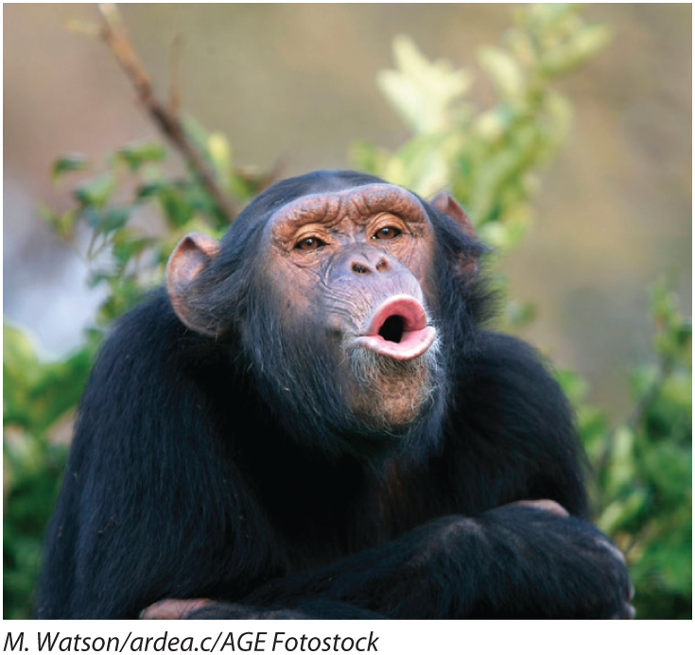
Bootstrapping: Estimating standard error and confidence interval
Notes:
Asymmetry in the Brodmann’s area 44, part of brain in humans that is associated with speech production, is important for language development
Researchers wanted to know if there is asymmetry in chimpanzee brains too
Scanned 20 chimps with MRI and recorded an asymmetry score (left measurement minus right divided by average of two sides)

Slide 25

Bootstrapping: Estimating standard error and confidence interval
Name of chimp | Asymmetry score
Austin | 0.30
Carmichael | 0.16
Chuck | −0.24
Dobbs | −0.25
Donald | 0.36
Hoboh | 0.17
Jimmy Carter | 0.11
Lazarus | 0.12
Merv | 0.34
Storer | 0.32
Ada | 0.71
Anna | 0.09
Atlanta | 1.12
Cheri | −0.22
Jeannie | 1.19
Kengee | 0.01
Lana | −0.24
Lulu | 0.24
Mary | −0.30
Panzee | −0.16
Median: 0.14
What is uncertainty (standard error) of the median?

Slide 26
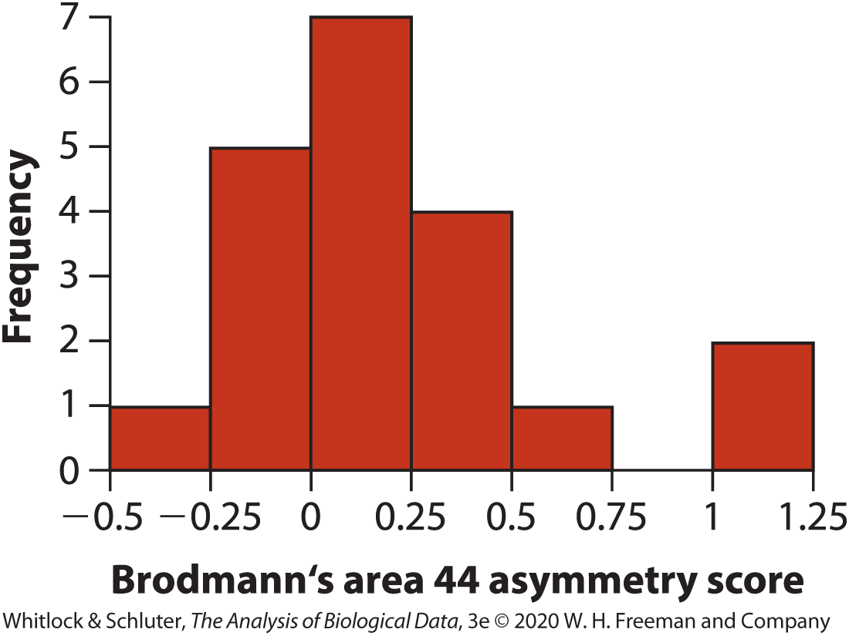
Bootstrapping: Estimating standard error and confidence interval

Slide 27
Bootstrapping: Estimating standard error and confidence interval
Randomly sample individuals from original data (with replacement)
Calculate the estimate based on the sample
Repeat many times (e.g., 10000)
Calculate standard deviation of all bootstrap replicate estimates (i.e., bootstrap standard error)

Slide 28

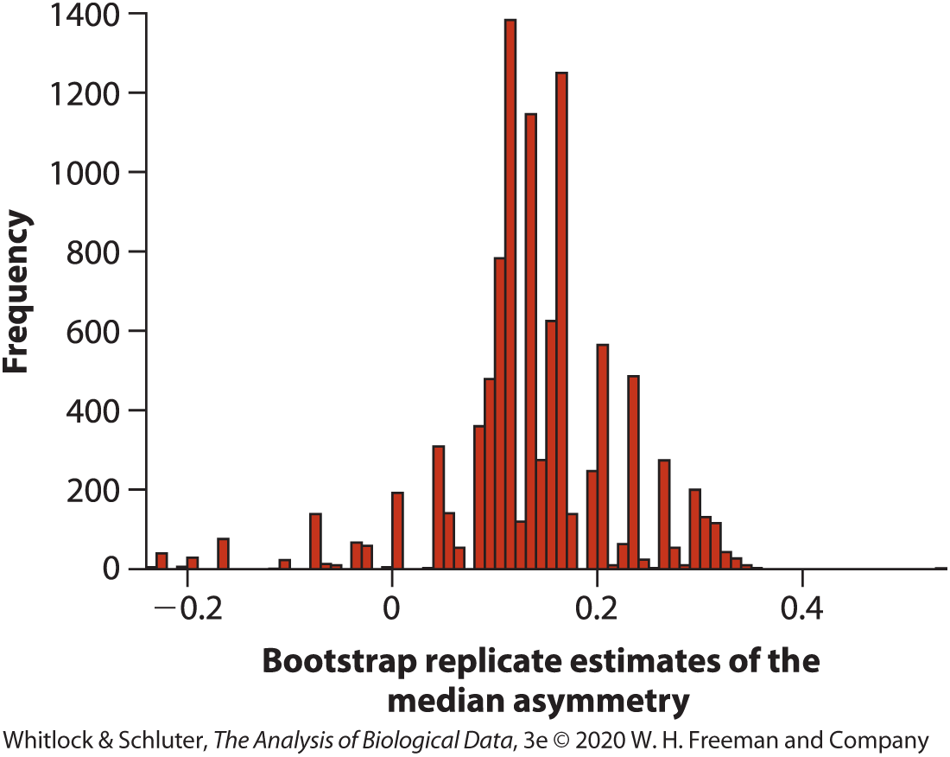
Bootstrapping: Estimating standard error and confidence interval
SE = 0.085
95% Confidence Interval
0.025 quantile to 0.975 quantile
-0.075<median<0.31
Notes:
Made it up to here in this lecture

Slide 29
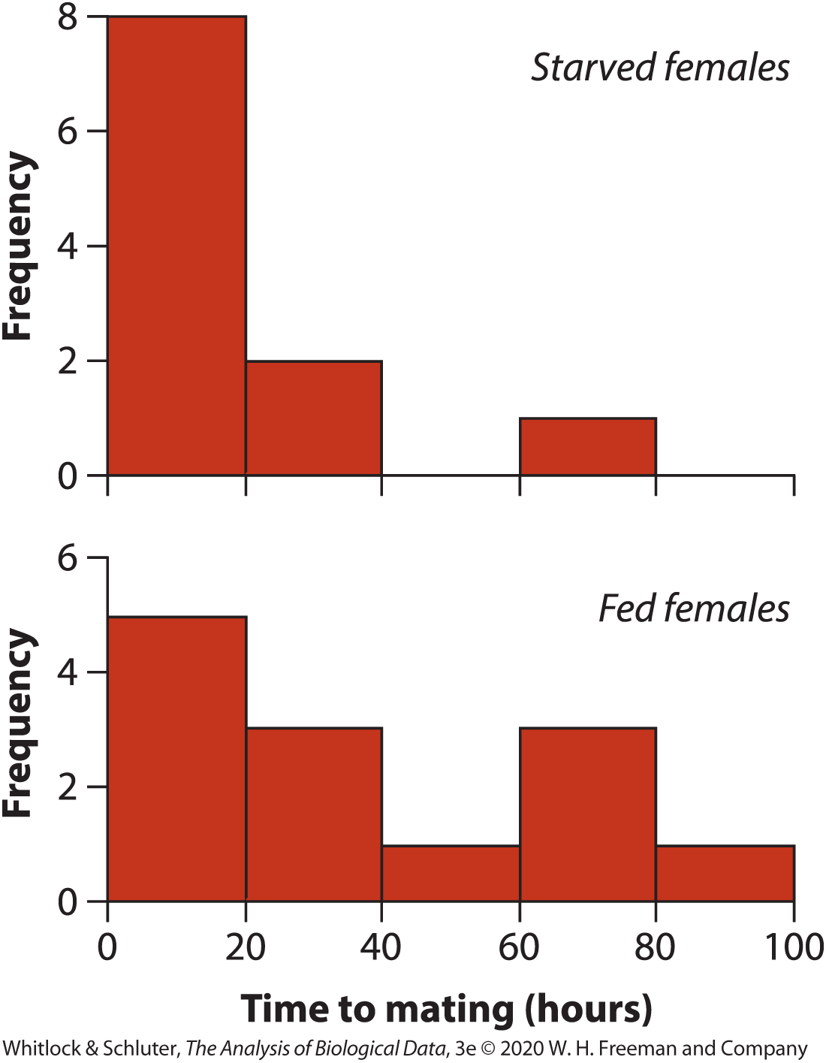
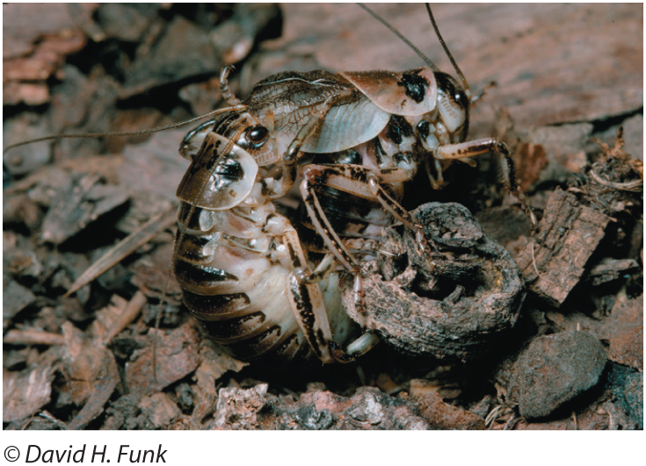
e.g., Sexual cannibalism in cave crickets
Bootstrapping with multiple groups
Notes:
-median time to mating was 13 hours for starved females and 22.8 hours for fed females

Slide 30
Difference in median time to mating: -9.8 hours 1) Resample from starved group (n=11) and fed group (n=13) 2) Calculate the median difference in the resampled data 3) Repeat 1000 times 4) Calculate confidence interval on the difference using bootstrap estimates of the difference
Bootstrapping with multiple groups
Notes:
-median time to mating was 13 hours for starved females and 22.8 hours for fed females

Slide 31
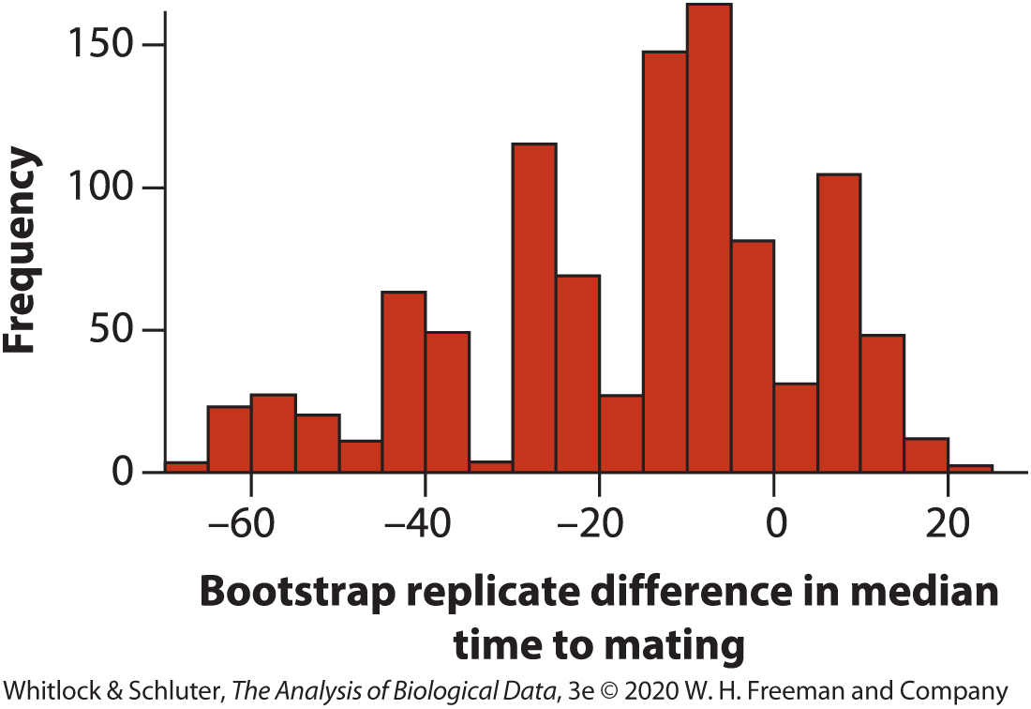
Bootstrapping with multiple groups
95% Confidence Interval (0.025 quantile to 0.975 quantile)
-62.5 < difference between medians < 12.2

Slide 32
Assumptions of bootstrapping
Each sample is a random sample from corresponding population
Sample must be large enough to reflect frequency distribution in the population
Bootstrap analyses on small samples will produce standard errors that are too small and confidence intervals that are too narrow, overestimating the precision of the estimate

Slide 33
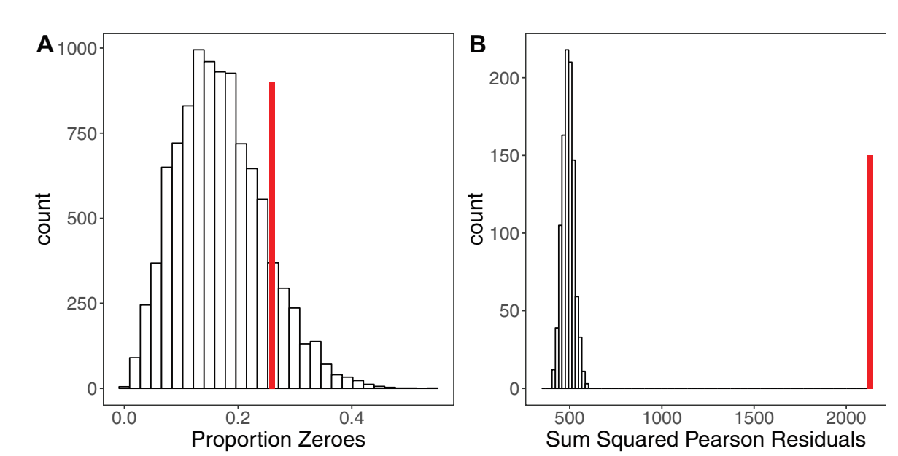
Simulation Further Applications
Assessing model fit for GLMMs (Harrison et al. 2017)
Notes:
-can use bootstrapping and simulation for more complex modeling
-example is in Harrison et al. 2017 (reading for tomorrow)
-excessive zeroes can be a problem with count data (may need to use zero-inflated models)
-they used simulation to generate 10,000 new data sets from a model they fit to see if there are more zeroes than expected due to chance
-in this case, their data set (observed number of zeroes, shown in Red) didn’t have more zeroes than would be expected by chance
-they used bootstrapping to determine whether there was evidence of overdispersion in their data
-re-sampled from simulated data 1000 times, each time calculated dispersion parameter and standard error
-compared expected sum of squares of pearson residuals under model with a dispersion parameter of 1 to the SS pearson residuals in the data

Slide 34
Summary
Non-linear modeling is used when predictor variables cannot be modeled as a linear function of the response variable

Slide 35
Summary
Non-linear modeling is used when predictor variables cannot be modeled as a linear function of the response variable
Non linear models often require multiple parameters to define the curve shape and are computationally complex

Slide 36
Summary
Non-linear modeling is used when predictor variables cannot be modeled as a linear function of the response variable
Non linear models often require multiple parameters to define the curve shape and are computationally complex
Simulation can be used in hypothesis testing where the frequency distribution of test statistics calculated on the simulated samples gives a null distribution of the test statistic

Slide 37
Summary
Non-linear modeling is used when predictor variables cannot be modeled as a linear function of the response variable
Non linear models often require multiple parameters to define the curve shape and are computationally complex
Simulation can be used in hypothesis testing where the frequency distribution of test statistics calculated on the simulated samples gives a null distribution of the test statistic
Bootstrapping can be used to calculate standard errors of estimates and confidence intervals of parameters by resampling from the data

